Slide 1
REGIME-BASED INVESTMENT MODELS AND MULTI-PERIOD MONTE CARLO SIMULATIONS
PROFESSORS LIONEL MARTELLINI, JOHN M. MULVEY AND DR. LEXIE LI
EDHEC AND PRINCETON UNIVERSITY
NOV 2021

Slide 2
Module Outline
Introduction to Python programming
Motivation for modeling economic regimes: example
Employ machine learning approach (trend filtering) over historical data
Work on scenario-based portfolio models (single and multiple)
Application: two-regime Monte Carlo simulation for a University Endowment

Slide 3
Introduction to Python

Slide 4
Python
General Purpose: build anything
Open Source! Free!
Many applications and fields
Python Packages, also for Data Science
Numpy
Pandas
Scipy
CVXPY
Statsmodels
Scikit-learn
...
Download version 3.x

Slide 5
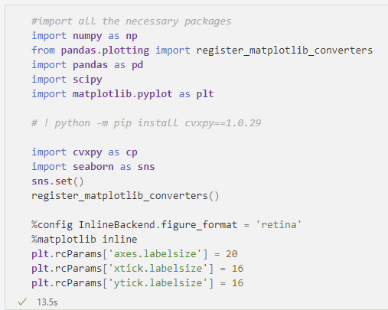
Import Packages

Slide 6
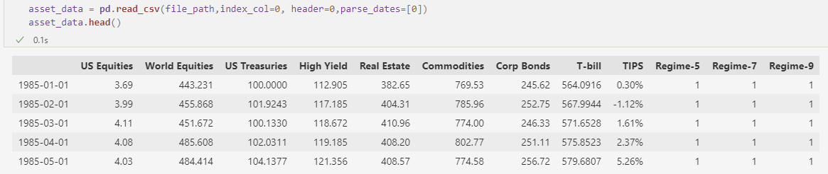
Get to Know Our Dataset

Slide 7
Introduction to Economic Regimes

Slide 8
Motivation for Modeling Regimes
Recap: Concept of a Regime
A period of time in which the characteristics of market performance and related economic activity are reasonably stable
Economic regimes should be distinctive from each other
Why do we use regimes?
Previous assumption: normally distributed returns
Is this a good assumption of the market?
Let’s see some real data!

Slide 9
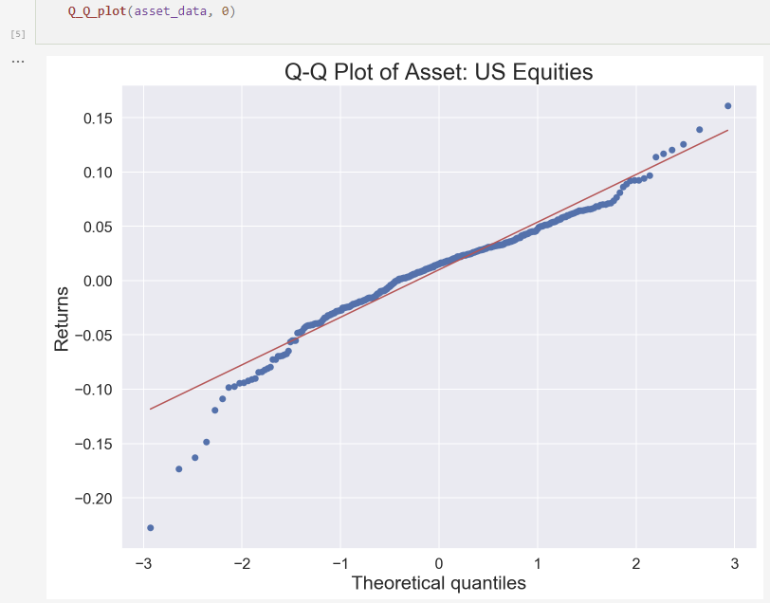
Market Return is NOT Normally Distributed

Slide 10
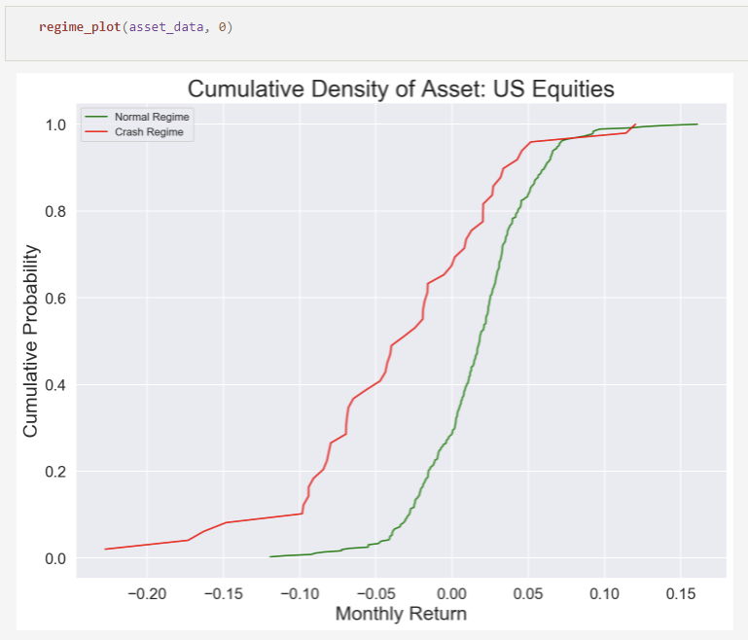
Plot the Distribution Under Each Regime

Slide 11
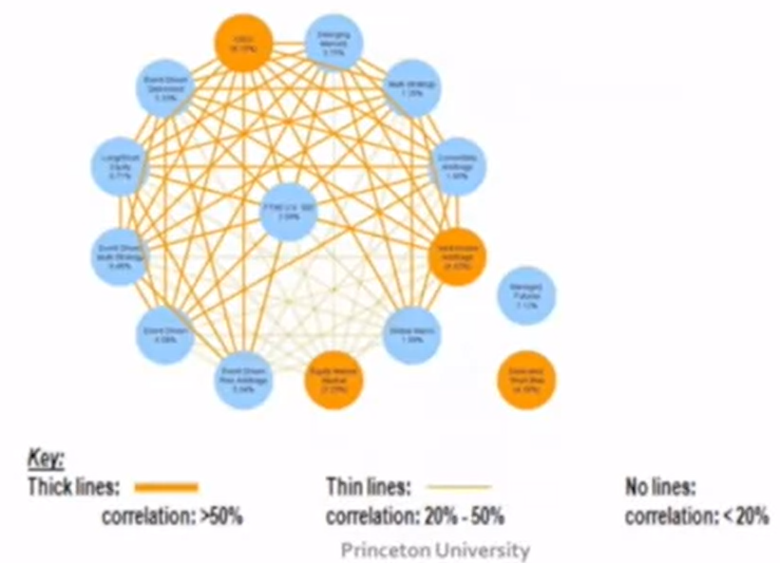
Motivate Economic Regimes – Correlation Perspective
Hedge fund performance with SP500 in Center
Note modest diversification over 2005 to 2011 period
Cross-Correlation Diagram
(Sept’05 – Aug’ 11)

Slide 12
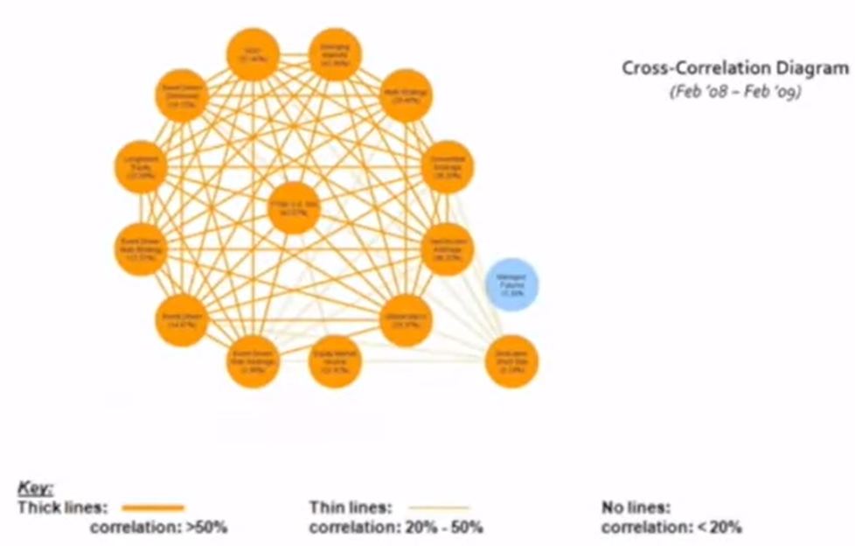
Crash Periods are Different than Normal Economic Periods
Much higher correlations and volatility during crash periods

Slide 13
A Machine Learning Method: Trend Filtering

Slide 14
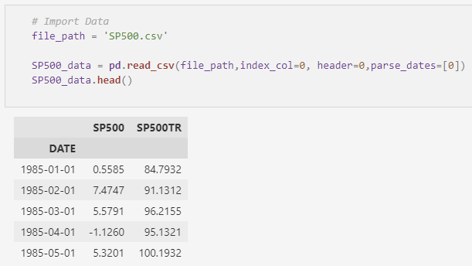
Trend Filtering Approach
Recap: “Filter” the index return time series
Balance between two goals:
Similarity between the filtered series and the historical series
Number of changes is direction
Apply to the S&P 500 Index

Slide 15
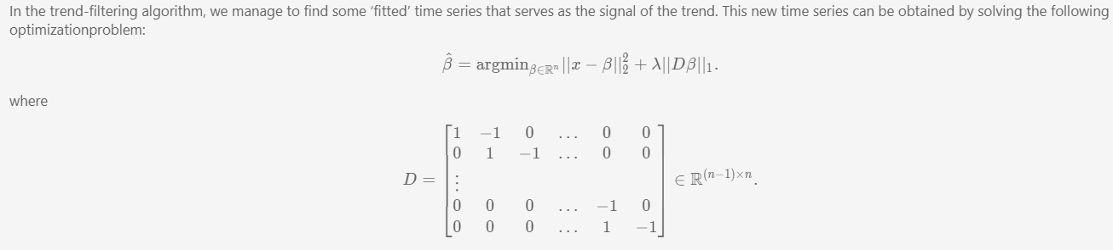
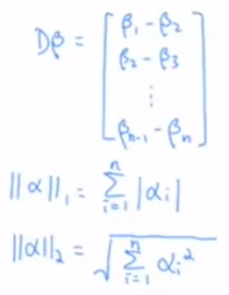
Trend Filtering
This is a convex program.

Slide 16
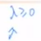
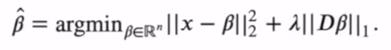
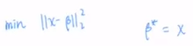
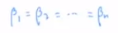
Parameter selection
What will happen if we increase the value of lambda? What if we decrease it?
Do we expect the regime labels to switch more frequently or less?
What happens when lambda = 0?
What happens when lambda approaches infinity?

Slide 17
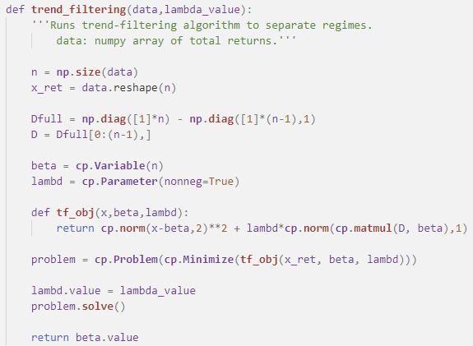
Trend Filtering (Code)

Slide 18
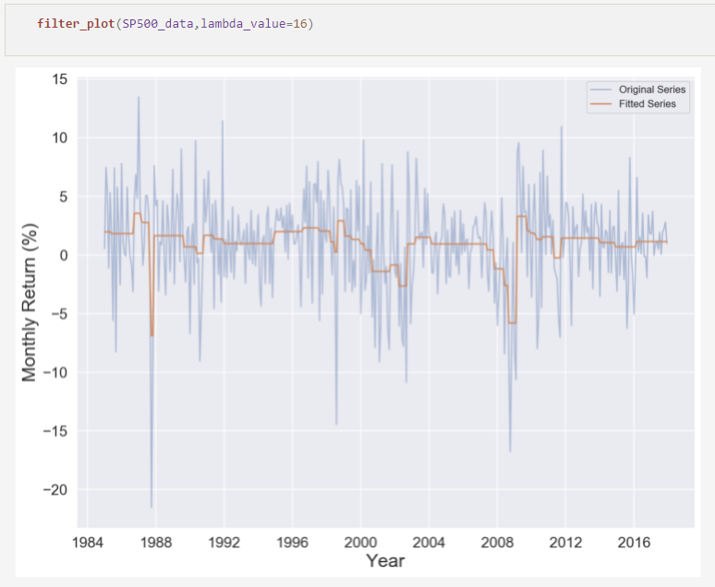
Fitted values by the Trend Filtering Algorithm

Slide 19
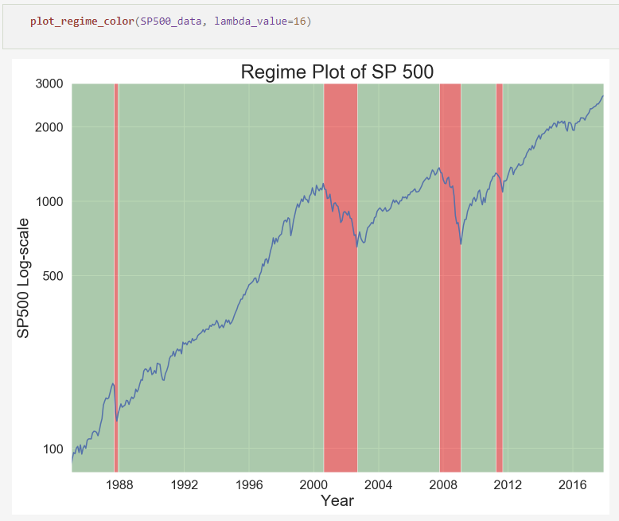
Plot the Regimes

Slide 20
A Scenario Based Portfolio Model

Slide 21
Markowitz Mean-Variance Model
Single-period asset allocation
Balance between two conflicting goals:
High expected returns
Low risk (low variance)
Minimize : portfolio variance
Subject to : expected portfolio return >= target expected return
budget constraints

Slide 22
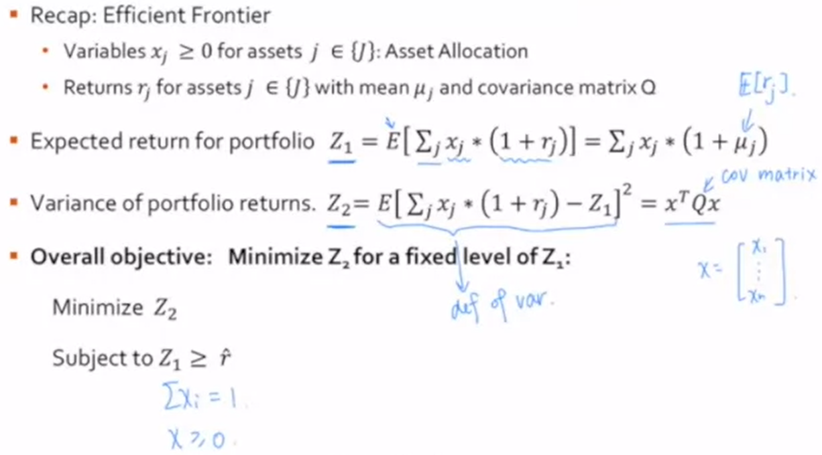
Efficient Frontier – Traditional Portfolio Model

Slide 23
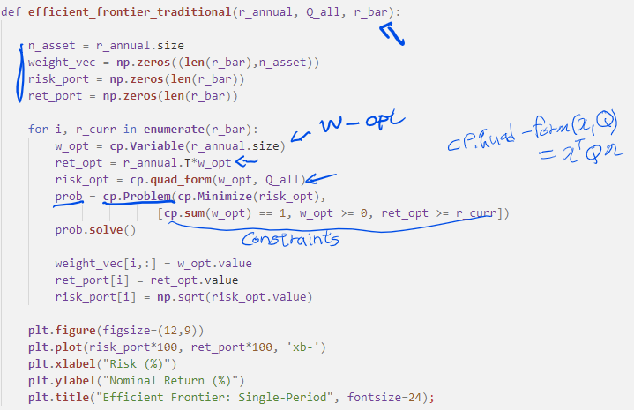
Efficient Frontier

Slide 24
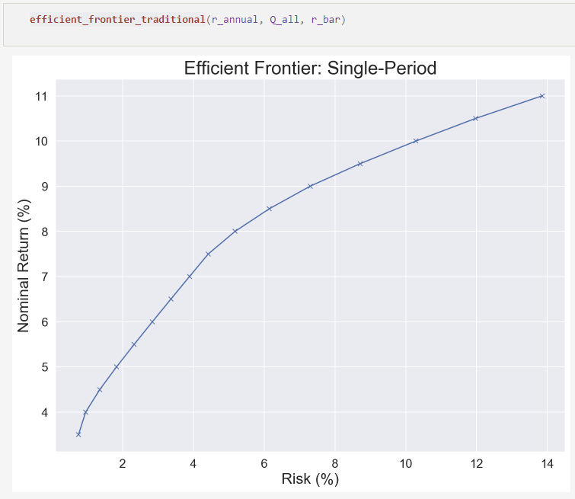
Example Efficient Frontier

Slide 25
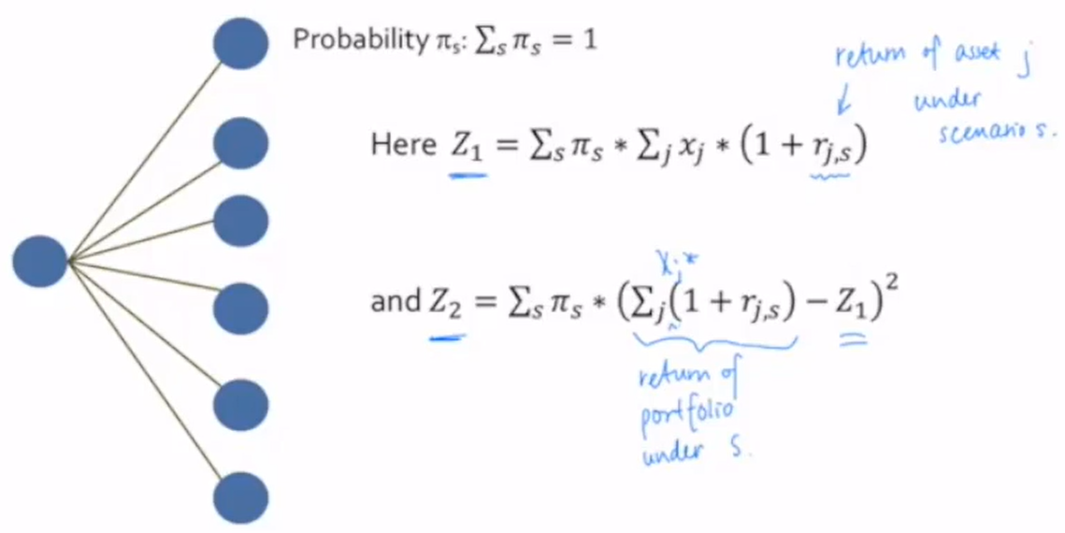
Single Period Scenario Tree {S}

Slide 26
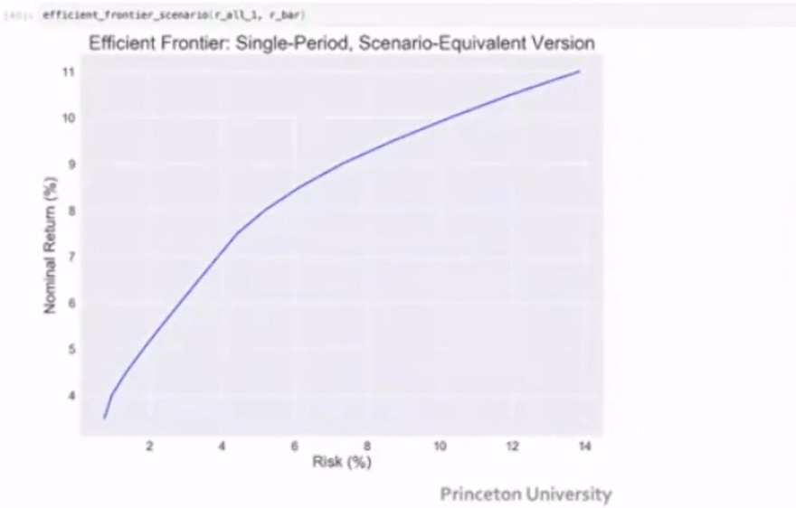
Scenario – Based Portfolio Model
Scenario version generalized easily
Other objective functions
Any distribution, allows for multiple regimes

Slide 27
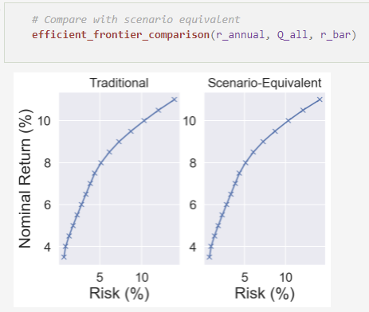
Comparing Efficient Frontiers
Scenario version and traditional version are equivalent

Slide 28
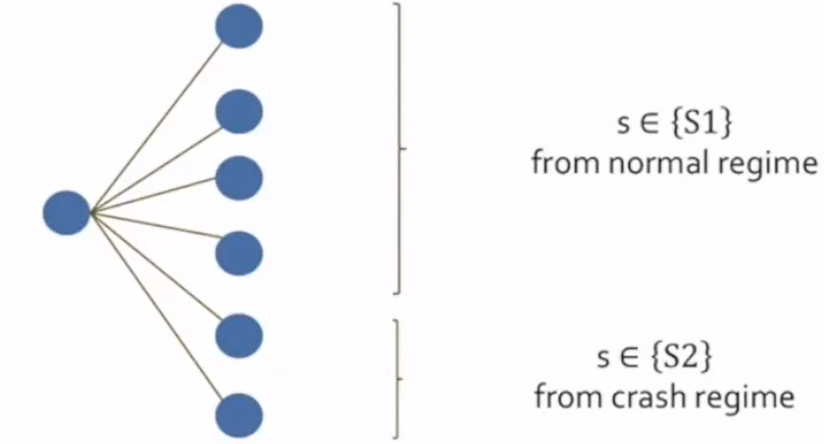
Single Period Scenario Tree {S} with Two Regimes
Proportionally split the scenarios

Slide 29
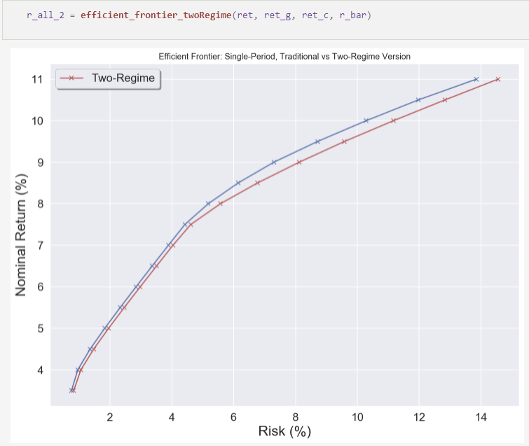
Traditional vs Two-Regime Model

Slide 30
A Multi-Regime Model for a University Endowment

Slide 31
Goals
Apply a multiple period asset model to a large U.S. University Endowment
Long horizon – 50 years
Assume fixed-mix investment for assets (annual rebalancing, no transaction costs)
Similar to leading university allocations in the U.S.
Start with annual spending (4%) and contributions
Compare single regime and two-regime approaches
Evaluate downside risks
Calculate probability of exceeding university thresholds

Slide 32
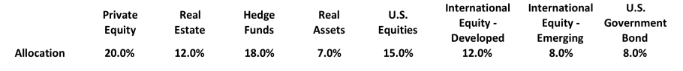
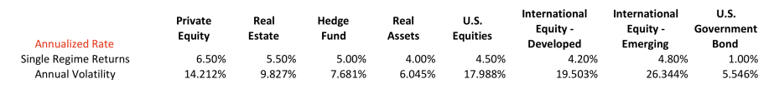
Endowment Management: Step 1: Asset Allocation Targets and Capital Market Assumptions
Panel A: Asset Allocation
Panel B: Projected Returns for Asset Categories – Single Regime
(Inflation adjusted)
Adjust returns across two regimes to match average
capital over the planning period

Slide 33
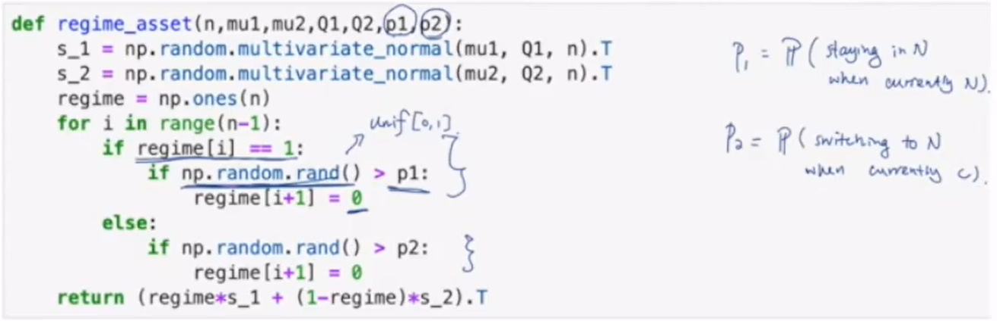
Multi-Period Simulation
Single regime
Simulate asset returns each period via a single multi-normal distribution
Two regime
Start with non-crash distribution
Switch between non-crash and crash each quarter depending upon transition probability

Slide 34
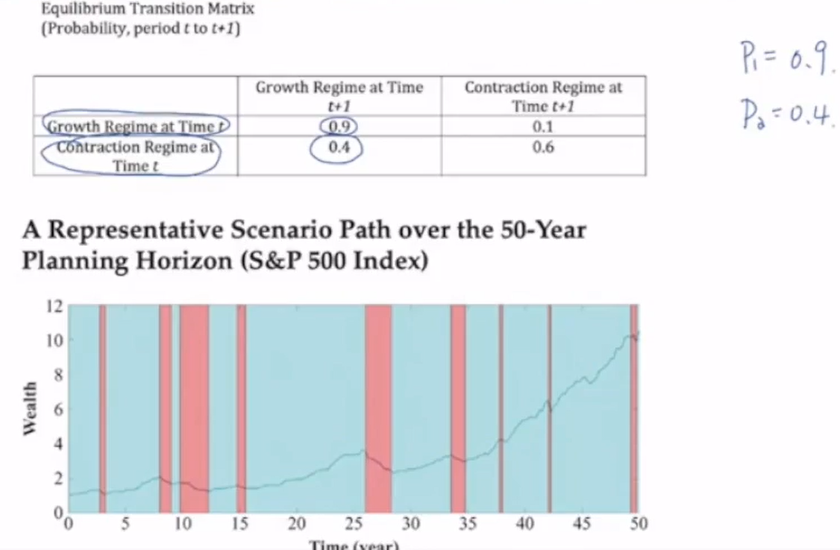
Multi-Period Simulation

Slide 35
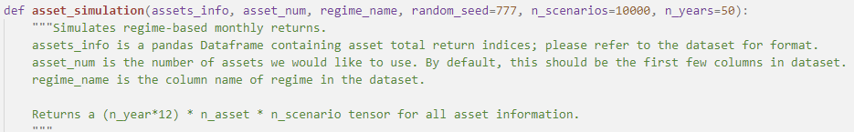
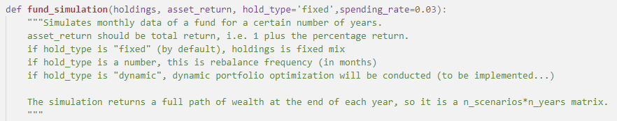
Simulation Functions

Slide 36
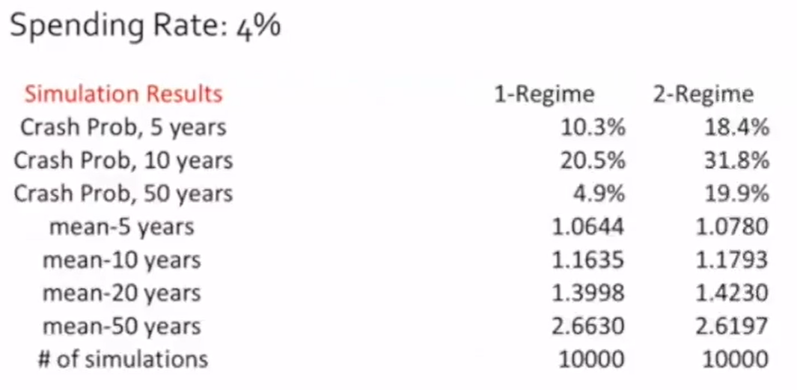
Outputs of Monte Carlo Simulation: Compare Single and Two-Regime Models

Slide 37
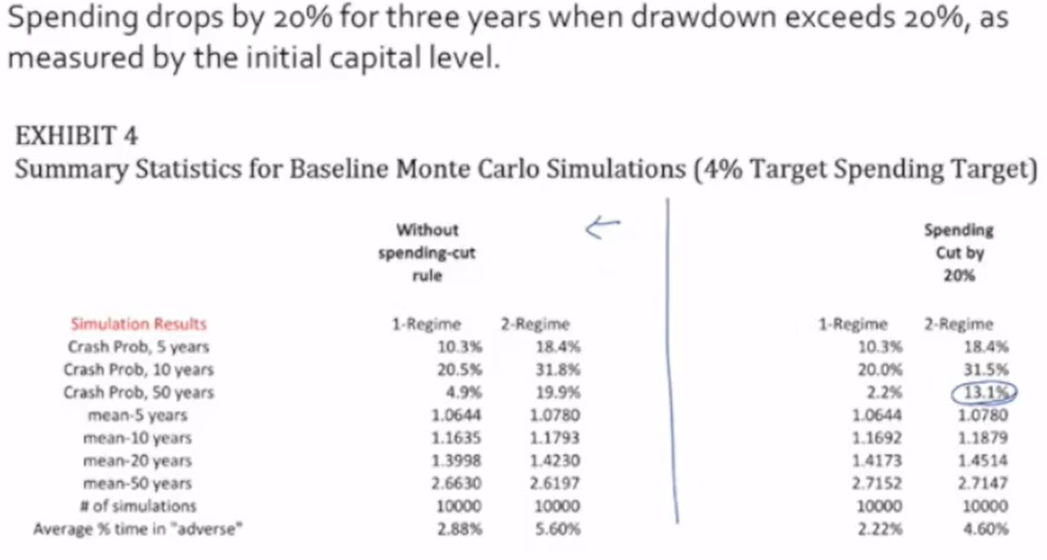
Comparison: spending cut during crash periods

Slide 38
Lessons for Other Investors
Address spending and savings issues
Individuals
In retirement – decrease spending during severe market drops
Planning for retirement – automatic enrollments, especially for younger workers
Larger penalties for withdrawing funds when changing companies
Pension plans – increase retirement age
Singapore – discussing inducements to work longer (6 to 7% added payouts after age 65)
U.S. increase payouts if retirement is postponed from 66 to 70 ($33k to $41k/year)
Sovereign wealth funds -> increase payouts during downturns (counter cyclic)

Slide 39
References
Mulvey, J. “Identifying Economic Regimes: Reducing Downside Risks for University Endowments and Foundations, “ Journal of Portfolio Management, 2016 (with H. Liu).
“Dynamic Asset Allocation for Varied Finanacial Markets under Regime Switching Framework, “ European Journal of Operational Research, G. Bae., W. Kim, and J. Mulvey 2013.
Nystrup, P., B.W. Hansen, H. Madsen, and E. Lindstrom. “Regime-Based Versus Static Asset Allocation: Letting the Data Speak.” Journal of Portfolio Management, Vol. 42, No 1. (2015), pp. 103-109.
R.J. Tibshirani. “Adaptive Piecewise Polynomial Estimation Via Trend Filtering,” The Annuals of Statistics, March (2014)
Guidolin, M., and A. Timmermann "Asset Allocation Under Multivariate Regime Switching,” Journal of Economic Dynamics and Control, Vol. 31, No. 11 (2007), pp. 3503-3544.

